Slide 1
Applied Software Security
Lecture 3

Slide 2
Program execution environment - user and system sides
Runtime, standard library and apis, system apis, syscalls, signals….

Slide 3
Runtime Environment - Preface
After seeing how virtual memory space is implemented, we can continue to a more detailed review of what a tasks memory space looks like.
In linux (as in many other OSs), the memory space of a task is separated into two parts:
An unprivileged part from which the tasks code as well as some unprivileged OS code runs. This part is often referred to as “user memory”.
A privileged part in which privileged operating system code and data reside, often referred to as “kernel memory”.
In the following illustration of the memory space of a linux task, the user / kernel memory is labeled “process / kernel virtual memory” respectively.

Slide 4
A side note on segments
Up till now, we have only mentioned the segment registers of the cpu and the fact that addresses are “offsets into segments”. To understand privilege levels a bit better, we will give a few more details of segmentation in 32 bit mode (in x86-64 64 bit mode operation, things are different as we will note in the end):
An address in protected mode of the processor (which is the operation mode in which most modern OSs operate in regularly), is considered as a “Logical address”.
A logical address is composed of a “Segment Selector”, and an offset.
The process translates a logical address to a “linear address”, in the following way:
If a new segment selector is loaded into the segment register indicating the selector for the translated address, it uses this index to locate the “Segment Descriptor” for the segment in the GDT / LDT (Global / Local Descriptor Table).

Slide 5
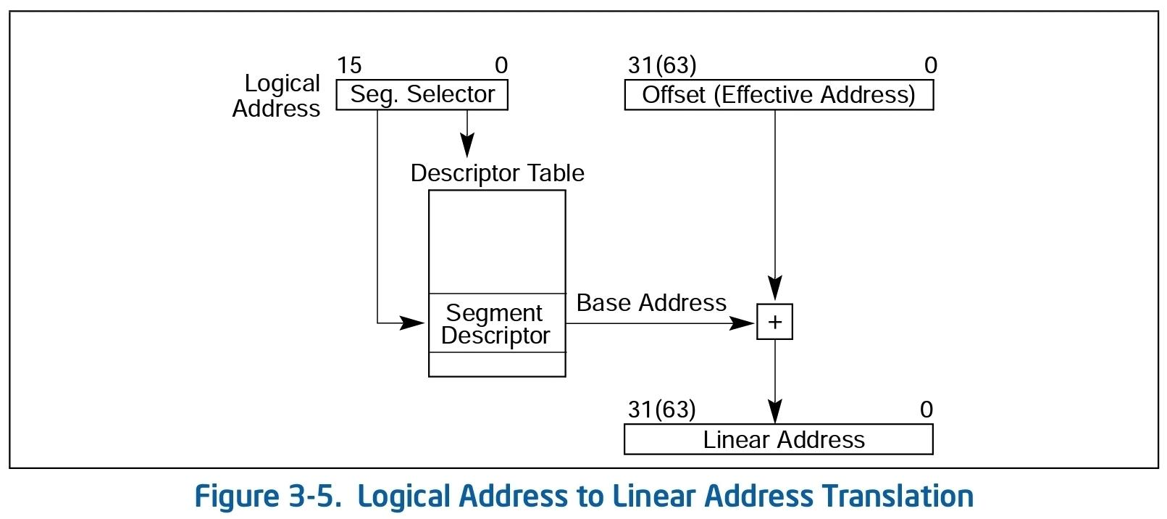
A side note on segments
Examines the segment descriptor and checks access rights to the segment, and that the offset is within the bounds of the segment.
Adds the base address of the segment (given in the descriptor) to the offset to form the linear address.

Slide 6

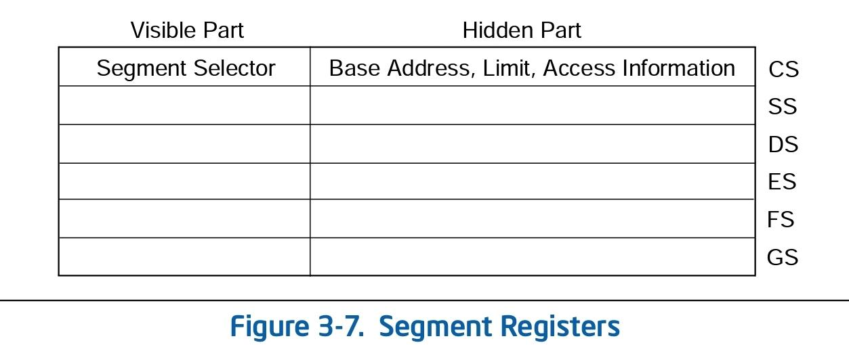
A side note on segments
If “paging” is not used, that is if the virtual memory mechanism is not enabled, the linear address is the physical address in the memory.
If virtual memory is used, the linear address is used as the virtual address, which is then translated by the mmu, as we have seen in the lecture about virtual memory.
Segment selector format:
Segment registers format:

Slide 7
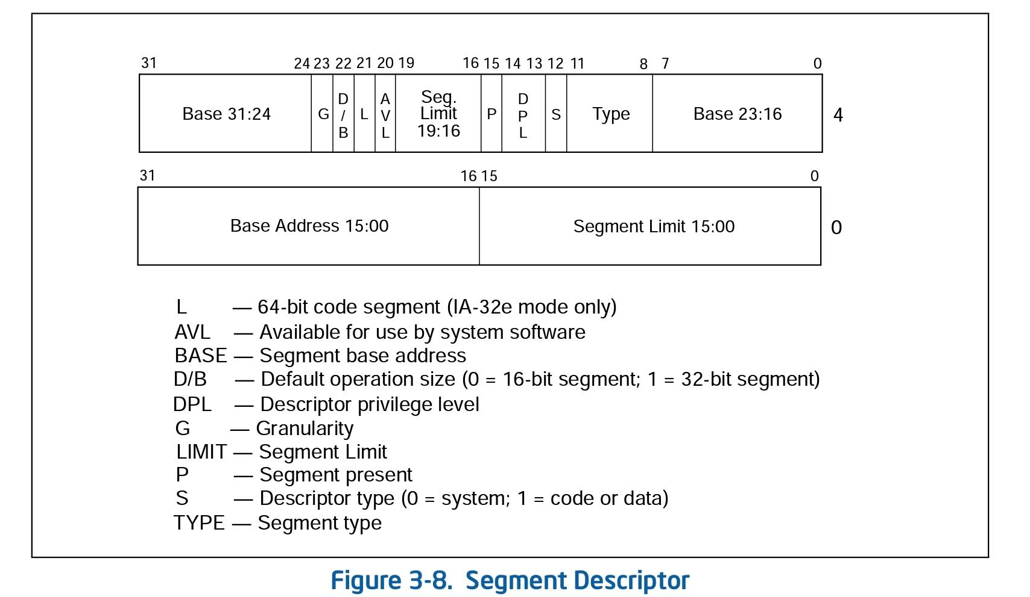
The index is an index into a Segment Descriptor Table, a table (array) consisting of Segment Descriptors of the following format (in 32 bit):

Slide 8
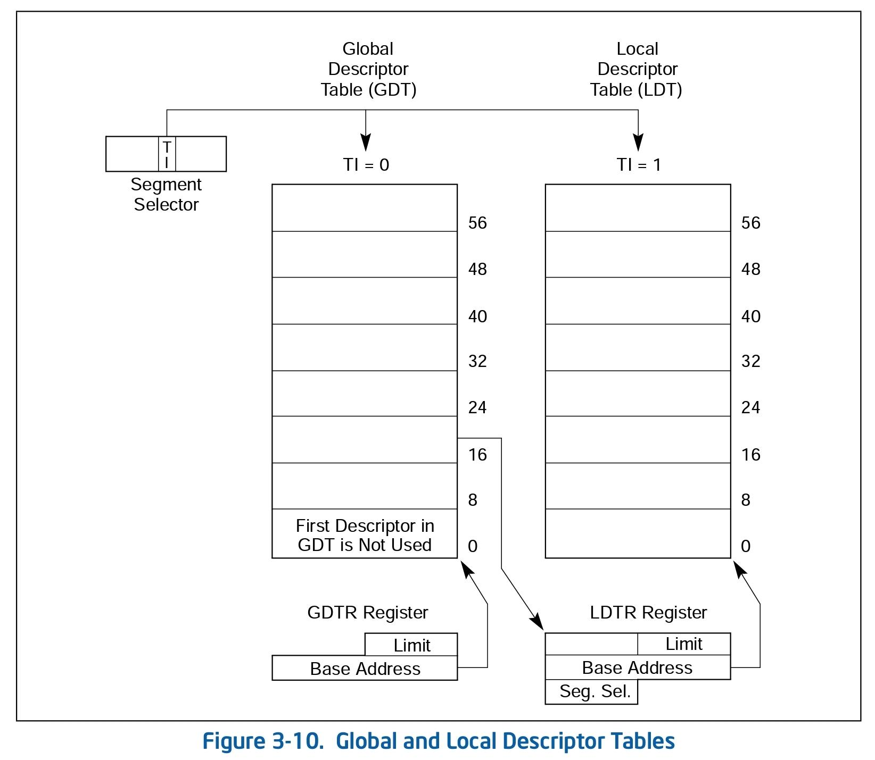
There are 2 types of Segment descriptor tables: Global (GDT) and Local (LDT).
The global descriptor table is given by a linear address in the GDTR register.
Local descriptor tables are located using segments in the GDT, but it’s linear address is also stored in the LDTR register to eliminate the need of translation.
Overall:

Slide 9
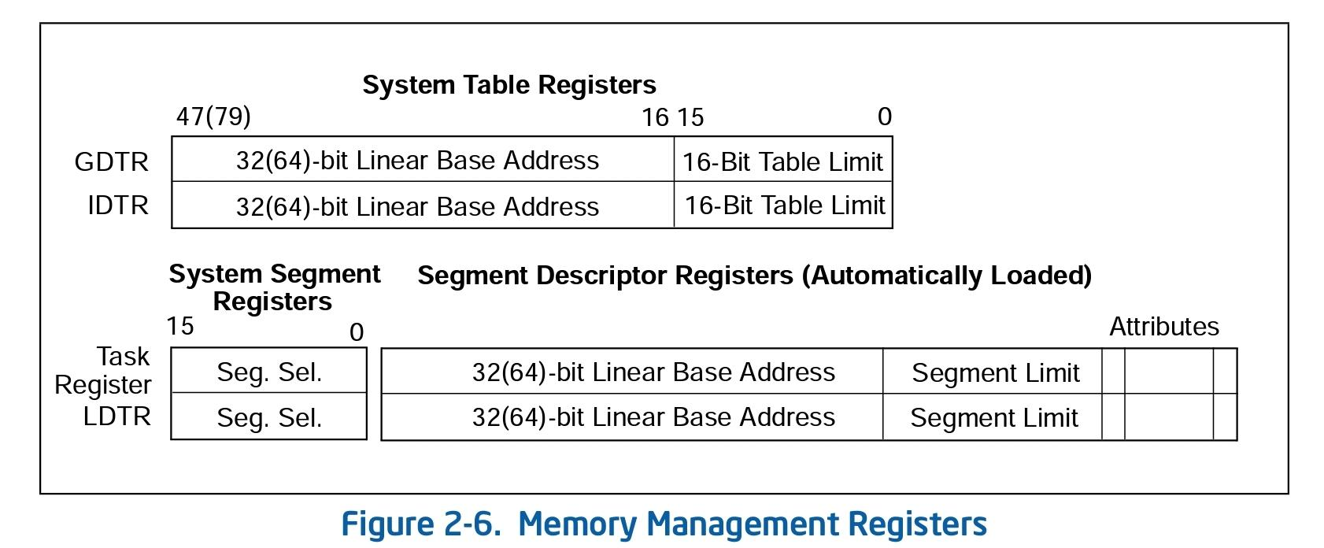

Slide 10
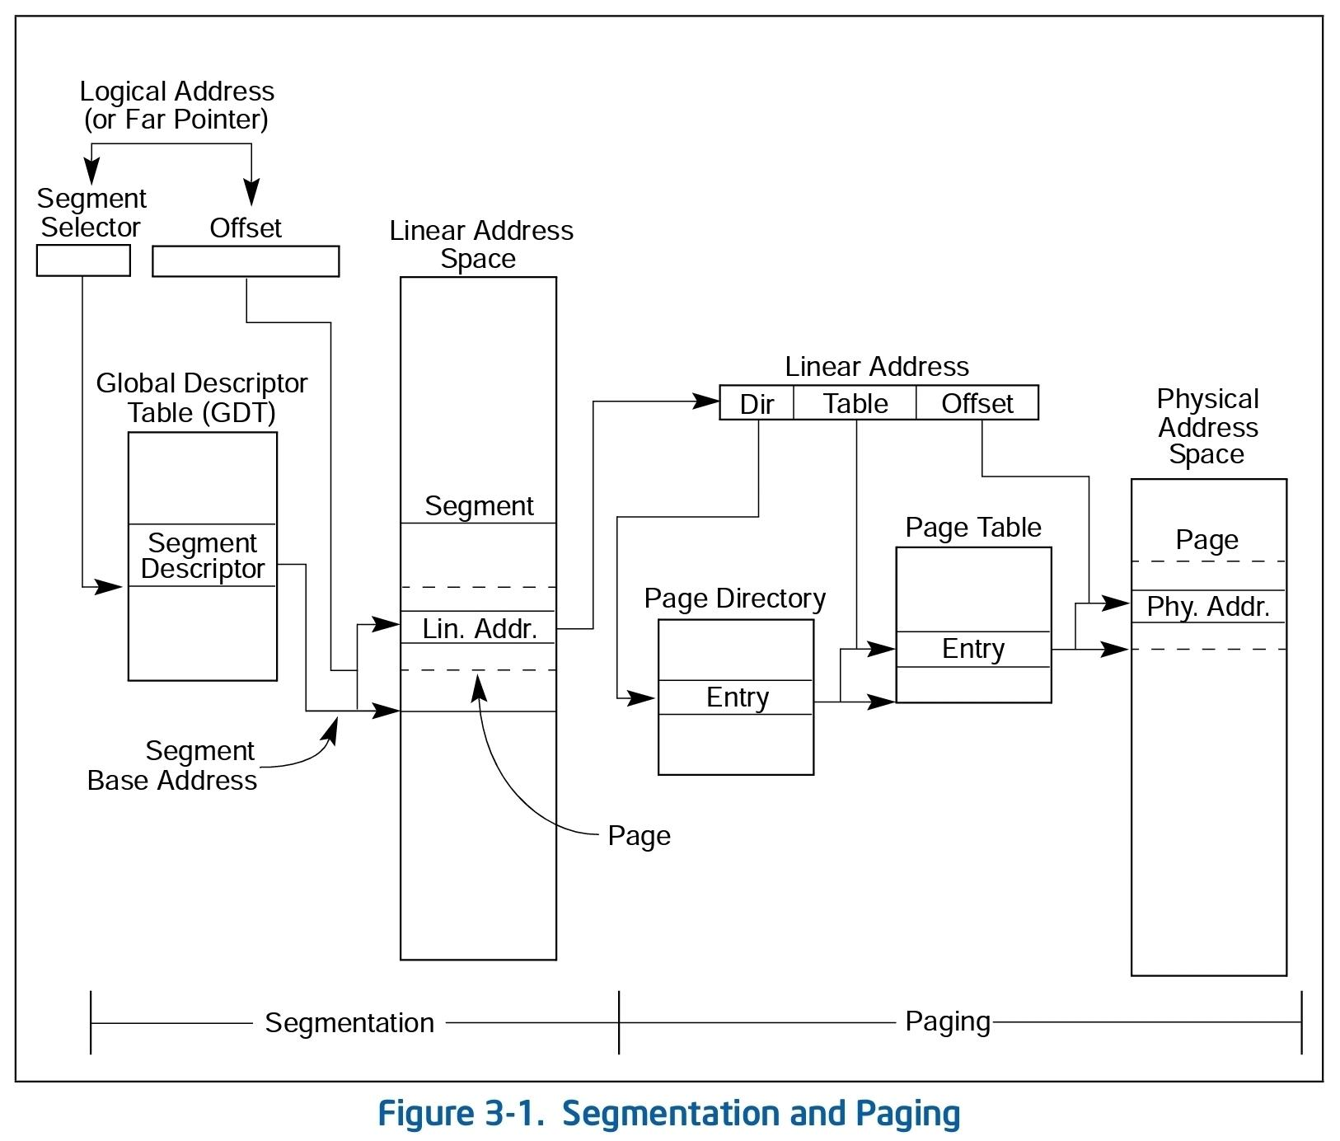
The overall address translation process should look like this:

Slide 11
In x86-64 (64 bit mode), things are a little different:
Segment descriptors are of the same size, which means the base is a 32 bit linear address, and so is the segment limit.
It seems* that in 64 bit the segment base is just always 0, the bounds is not really checked, and in general the descriptors are only used to indicate the mode of operation of the processor (aside for the segment registers FS and GS), for privilege checks.
* https://nixhacker.com/segmentation-in-intel-64-bit/#:~:text=In%2064%2Dbit%20mode%2C%20segmentation,and%20GS%20segments%20are%20exceptions.
* https://stackoverflow.com/questions/57222727/is-segmentation-completely-not-used-in-x64

Slide 12
Privilege level checks (an overview)
The processor recognizes 3 type of privileges for a segment:
Current privilege level (CPL) - The privilege level of the currently executing program. Stored in bits 0 and 1 of the CS and SS registers. Normally it is the privilege level of the segment from which instructions being fetched, and is changed when calling code in a different segment.
Required privilege level (RPL) - An override privilege level, assigned to segment selectors (stored in bits 0 and 1 of the selector). This is more or less the privilege level in which code that wants to access the segment indicated by the selector, must operate in to be allowed to do so.
Descriptor privilege level (DPL) - The privilege level of a segment or gate descriptor. The use is dependent on the kind of segment (the type field in the segment descriptor) and the kind of access:

Slide 13
Privilege level checks (an overview)
For data segments - The DPL is the highest (number, that is lowest privilege) value of CPL a program can be executing in and access the segment.
For call gates (segment accessed through a call gate descriptor) - same as the data segment.
For non conforming code segments without a call gate - The exact level which the CPL must be to access the segment.
For conforming code segments / non conforming accessed with a call gate - The lowest (number, that is highest privilege) value of CPL a program can be executing in to access the segment.
To sum up, the access checks related to segments are:

Slide 14
Privilege level checks (an overview)
For data segments: CPL <= DPL of descriptor and CPL <= RPL of selector of descriptor.
For code segments:
Without a call gate:
Non conforming - CPL == DPL of descriptor, RPL <= CPL
Conforming - CPL >= DPL of descriptor, (RPL not checked).
Using a call gate: Accessed only though a far call or jmp instruction -

Slide 15
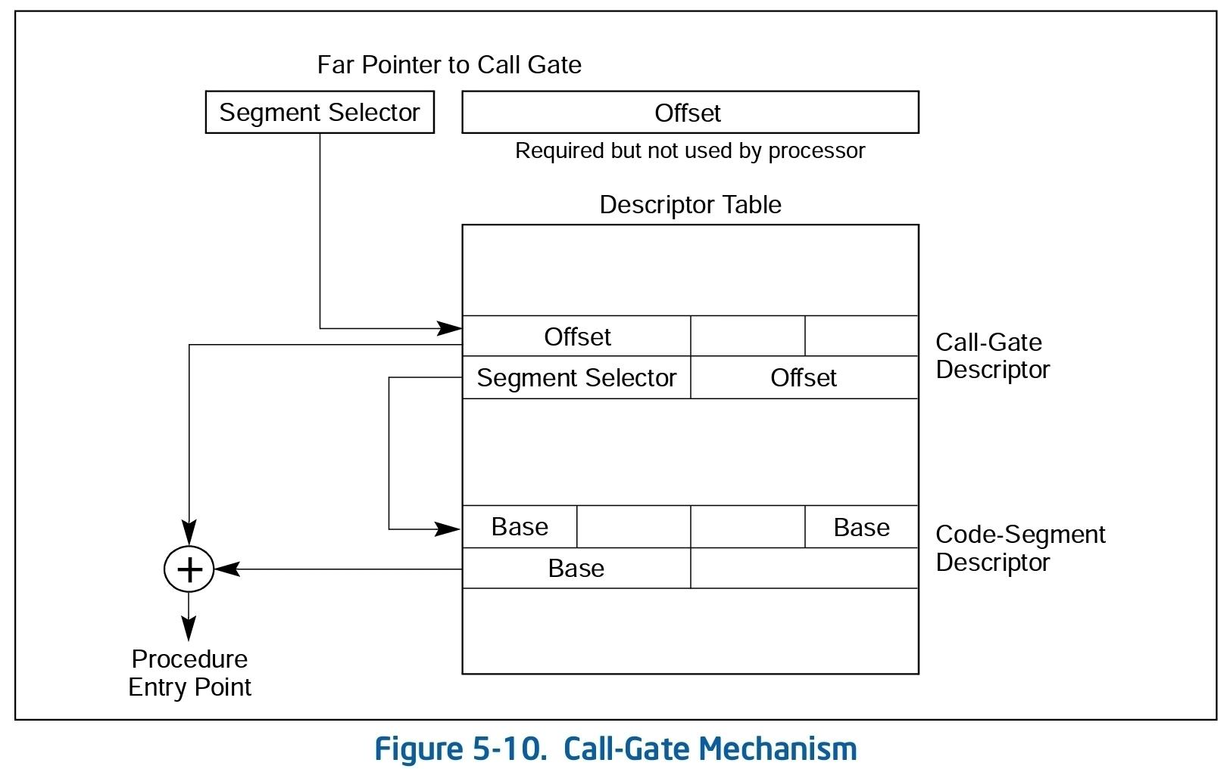

Slide 16
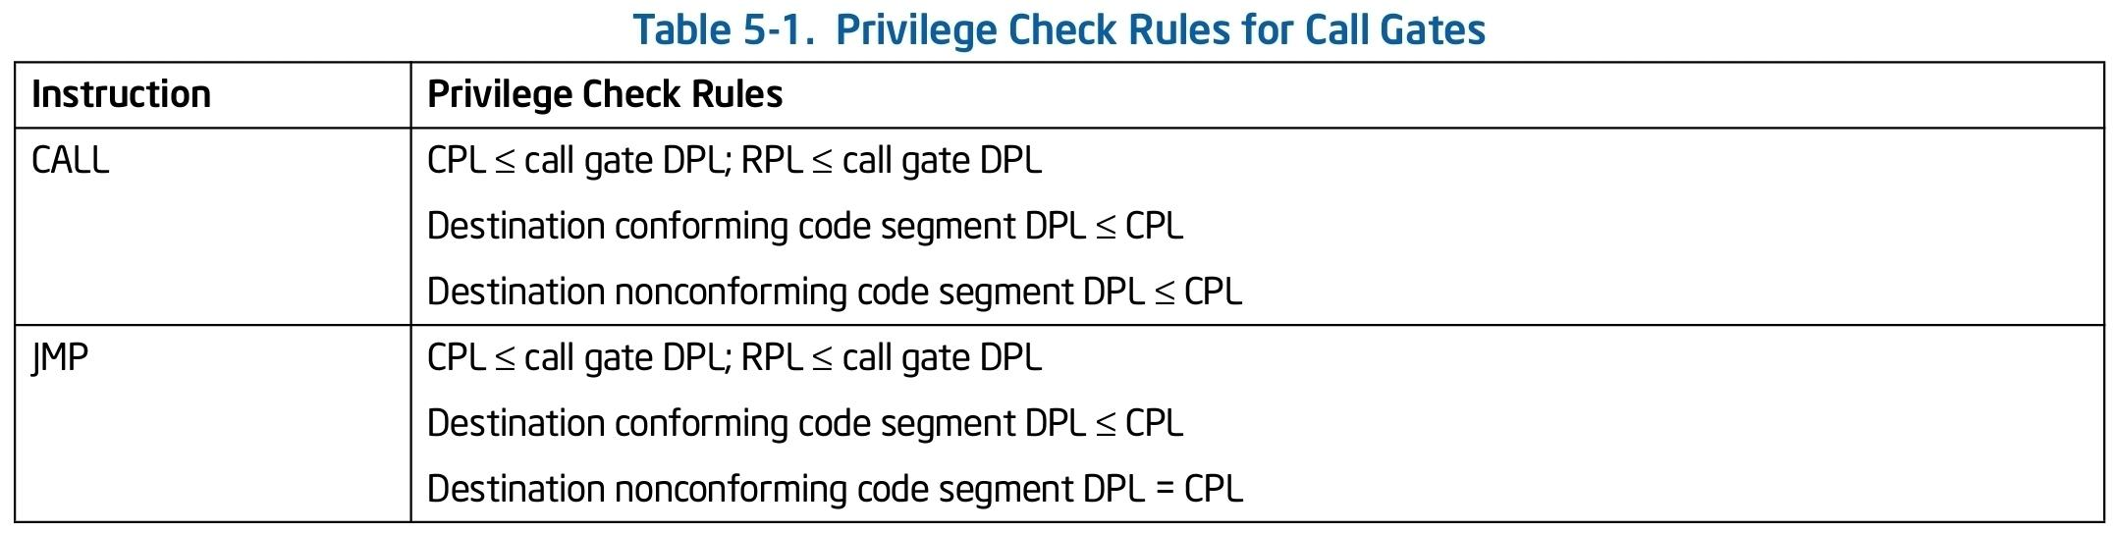
Note: The actual privilege separation in linux is done using the CPL and the page level protection mechanism, which we have seen in the previous lecture. We will see this shortly.
Enough of this overview, back to an overiew of the runtime environment.
For *much* more, see sections 3 and 5 of
https://www.intel.com/content/dam/www/public/us/en/documents/manuals/64-ia-32-architectures-software-developer-vol-3a-part-1-manual.pdf

Slide 17
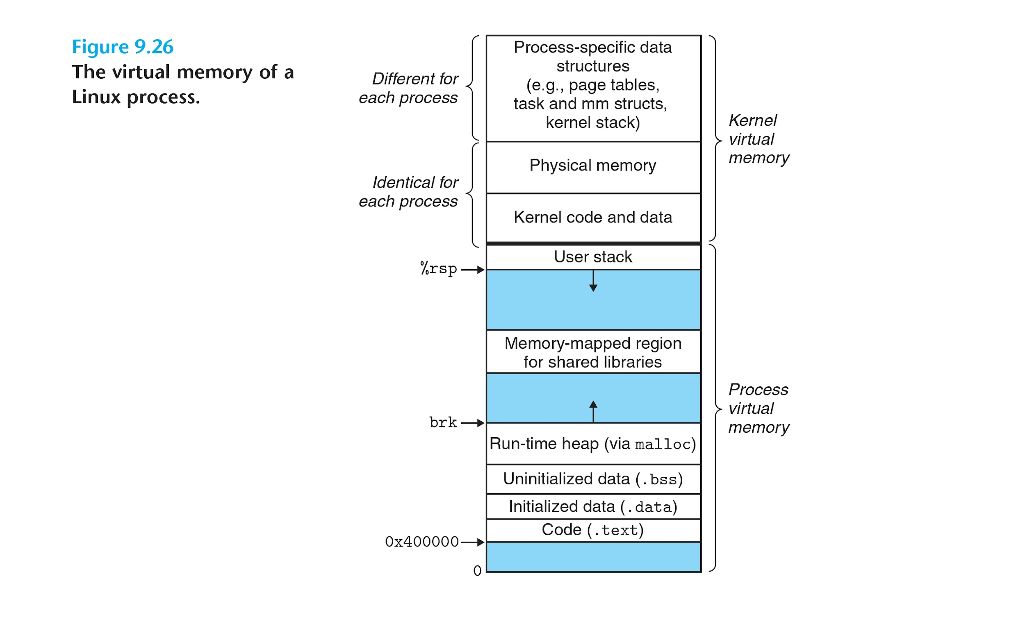

Slide 18
Runtime Environment - Preface
The separation into kernel and user memory is done via the owner (user / supervisor) bit of the PTE of a page, and the current privileged level of the code determined by the segment registers:
The kernel memory is mapped*^{see note later} (the PTEs are set) with owner bit set to supervisor, and the user memory is mapped with owner bit set to user.
The user code runs in (with segment register CS indicating (that is indexing a segment selector inicating)) “unprivileged mode” (aka user mode), and the kernel code runs in “privileged mode” (aka kernel mode).
Pages that are mapped with owner supervisor cannot be accessed by code running in unprivileged mode. This way the code of each task (operating in user mode) cannot access the privileged memory in which the OS operates.
As we have just seen, segmentation also offers privilege separation for data access using the segment registers, but as the MMU is used for virtual memory, the (legacy) segmentation privilege mechanism is (mainly) used for the support of the current privilege level of running code.

Slide 19
Runtime Environment - Preface
Some instructions are privileged instructions, and can only be run when CS indicates privileged code. Such instructions are for example loading values into segment registers.
This way when the OS wants to “give runtime to a task” (that is execute the tasks code) it can execute it with a non privileged CS, and limit it’s capabilities*.
As the kernel memory is unaccessible to the task’s user code, and is mostly identical for all tasks, the OS can actually use the same memory for the kernel code in different tasks.
A big part of the kernel code and data is mapped**^{see note later} across all tasks, that is the PTEs mapping the upper memory of the address space are (or at least can be) the same across tasks.
* This actually requires also the use of a bit more, in practice clock interrupts (we will come back to this).

Slide 20
Runtime Environment - Preface
Note Later: After meltdown, most of the kernel space not really mapped when running in user mode - the kernel (privileged OS code) maintains two page tables: one for when the cpu is executing in user mode in the context of a task and does not map (most of) the kernel memory, and one for when the cpu is executing in kernel mode in the context of the task and does map the kernel memory.
We will expand on meltdown in the second part of the course.

Slide 21
Runtime Environment - common operations and services
The operating system offers several utilities and services to executed tasks, which can be coarsely separated into two levels:
“unprivileged” utilities:
common operations on strings (e.g. strchar)
fast / lightweight small memory allocations (e.g. malloc)
common memory operations (e.g. memcmp)
“privileged” utilities:
virtual memory operations (e.g. mmap, mprotect)
file operations (e.g. open, read)
networking operations (e.g. socket, send)
input / output operations (e.g. printf)
inter-process communication (e.g. pipe, signal)
system and machine resources related operations (e.g. threads, timers, etc)

Slide 22
Runtime Environment - privileged utilities - motivation
In order to preserve the separation between tasks and between a task and the OS, some operations that the OS would naturally like to offer user code must be restricted / managed by the OS
virtual memory operations - mapping and unmapping memory at arbitrary addresses, while isolating physical memory of different tasks and OS, also requires touching the page tables, and might alter OS code mapped in the tasks address space.
file operations - storing data persistantly is a very common operation for most applications. To do so a mass storage device (“disk”) can be used, and in order to enforce separation between different tasks’ data, and between OS and task data, the OS should oversee access to this device.
In addition, rather than have each task implement management code for it’s logical persistent data units on the physical device, the OS offers an api to manipulate such units.

Slide 23
Runtime Environment - privileged utilities - motivation
networking - communicating with remote machines, while enabling isolation of communications channels of different tasks and of OS and tasks.
inter-process - communicating with other tasks ….
input / output - separating input / output (IO) of different tasks and the OS. Additionally implementing an api that enables applications to access hardware devices, while restricting their access to preserve separation.
The common “efficient” way in which (most) privileged operations are performed, is via the system call mechanism (aka system calls / syscalls).

Slide 24
System calls
System calls provide a way in which code running in unprivileged mode can call priviliged code - Using designated machine instructions (sysenter/syscall and sysexit/sysret).
When a syscall is executed, the instruction pointer, stack pointer (and segment register) are switched to values that are predefined by the OS (a privileged cs, instruction pointer to system code that handles the syscall, and a stack pointer pointing to a “kernel stack” - privileged memory designated for the stack) and are restored to the appropriate values upon return via the corresponding sysret/sysexit instruction.*
This way, unprivileged user code can call privileged system code to preform privileged operations as described previously.
The OS can then enforce the access to the priviledged resources, implementing the appropriate restrictions.

Slide 25
System calls
Note: In linux x86-64, switching between the context of user/kernel mode is done using the Task management mechanism and Task State Segment (TSS) feature of the cpu. We will not go into details here. *
* For more details, see sections 5.8.8 (5.8.7 for 32 bit) and 7 (specifically 7.2.1 and 7.7) of
https://www.intel.com/content/dam/www/public/us/en/documents/manuals/64-ia-32-architectures-software-developer-vol-3a-part-1-manual.pdf

Slide 26
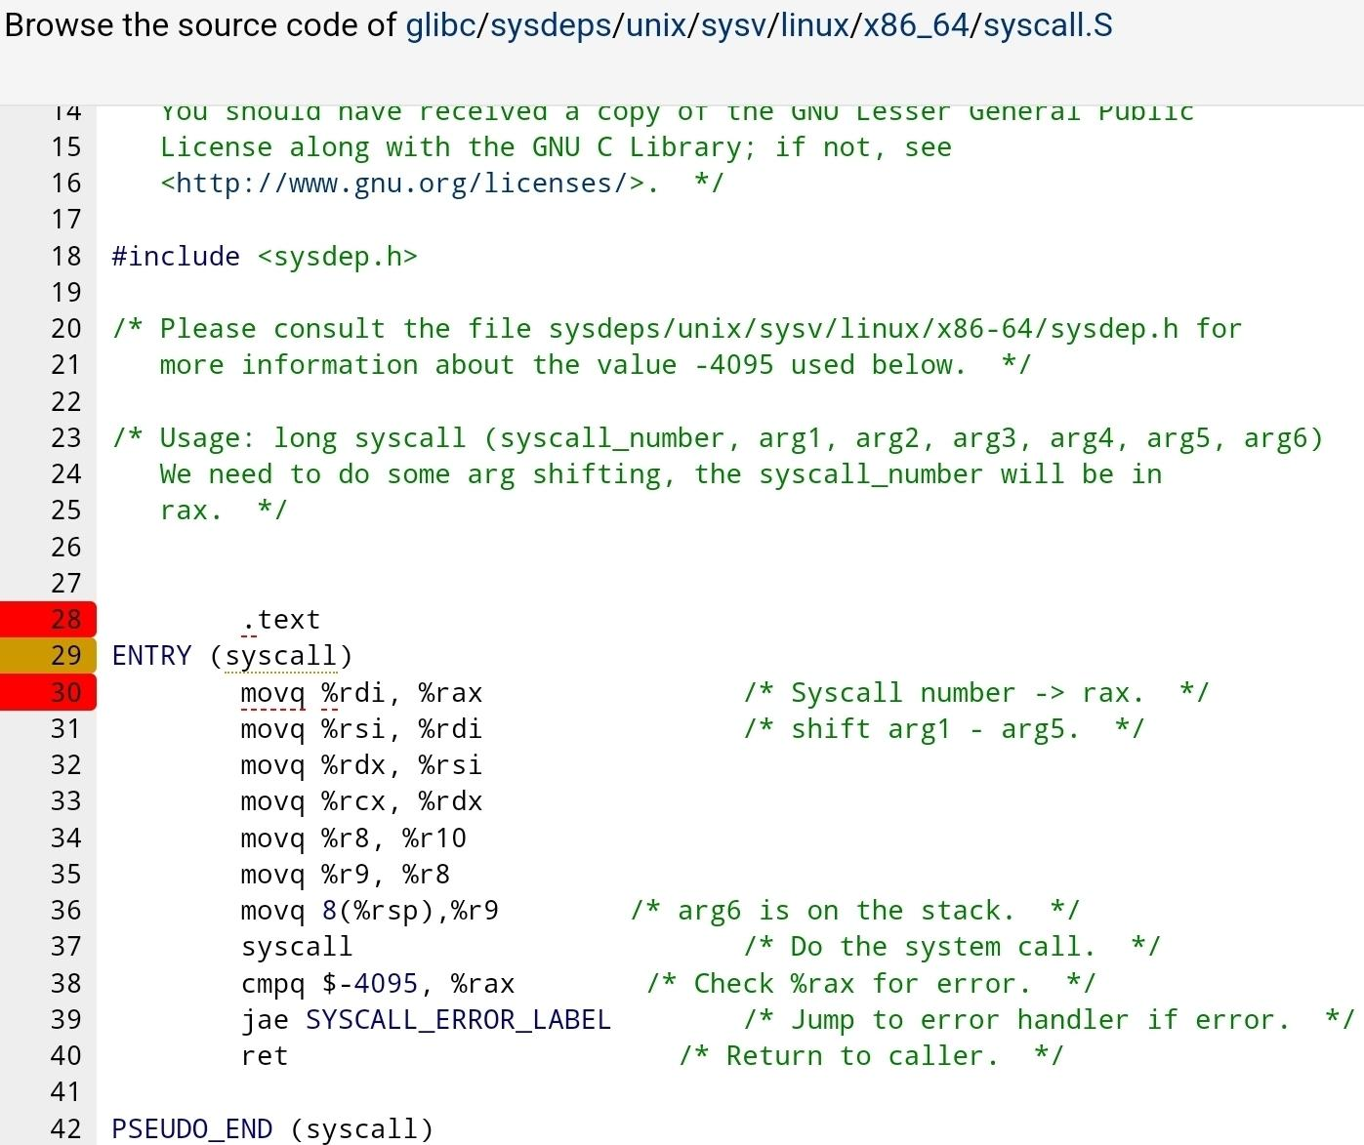
System calls

Slide 27
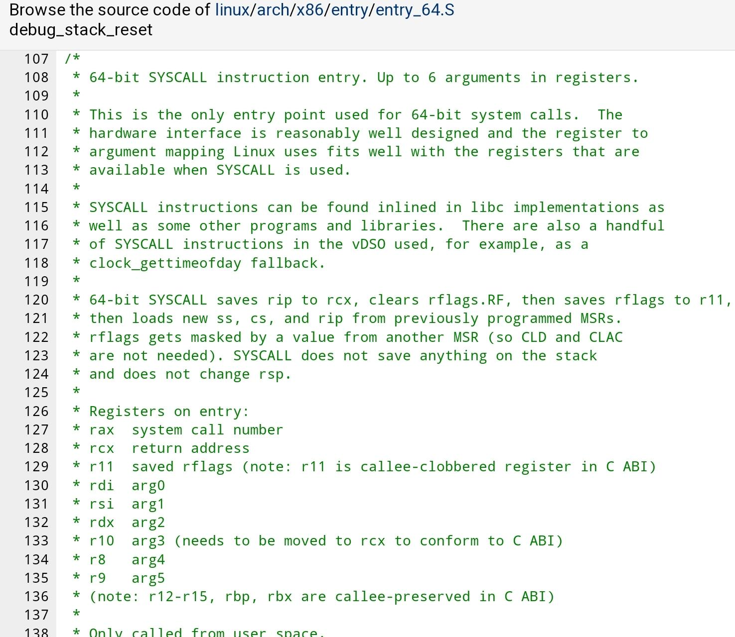
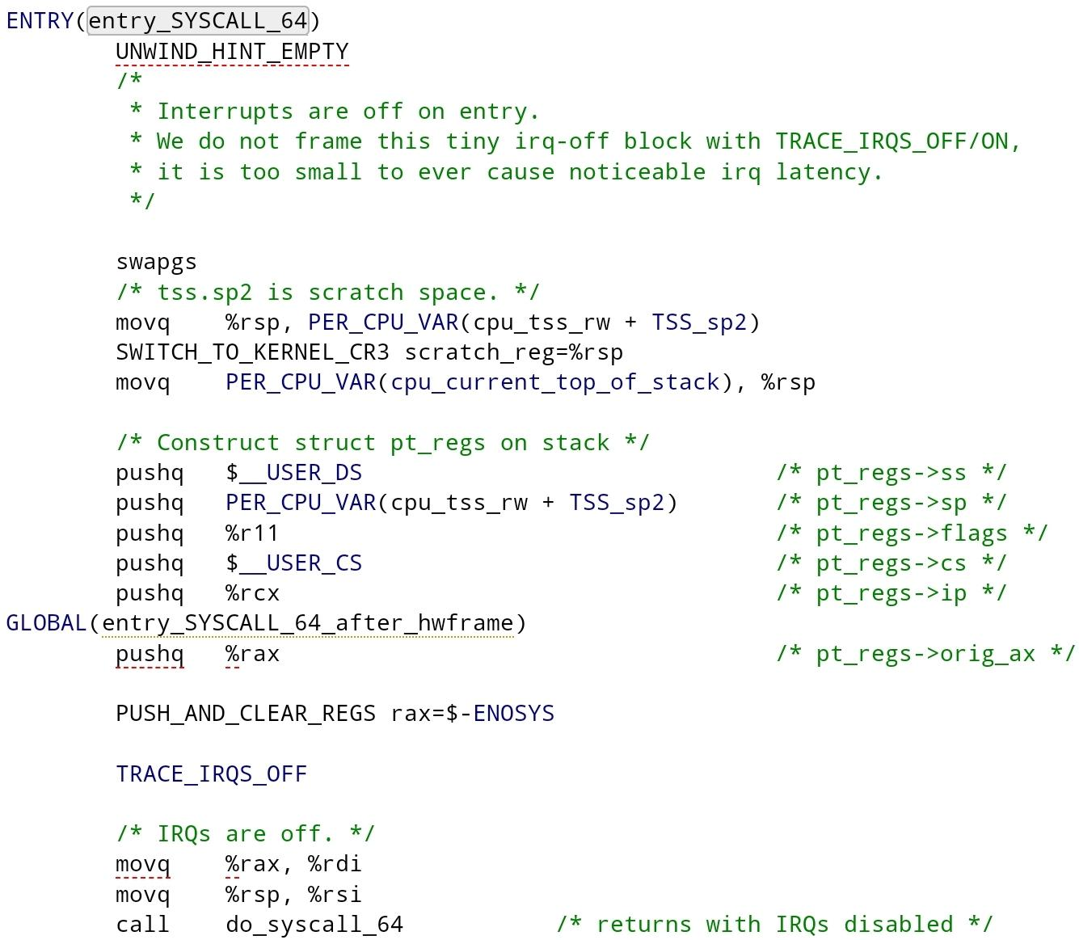
System calls

Slide 28
"Historical Note”
Before the introduction of the designated syscall/sysenter instructions, system calls were implemented using the interrupt mechanism of the cpu, a more general way to perform calls between different privilege levels. We will go into interrupts and traps later.

Slide 29
Some very common and useful system calls
virtual memory operations: mmap, munmap, mprotect (change the protection of a memory map), madvise.
file operations: open, close, read, write, lseek, fcntl, ioctl, (e)poll.
networking: socket, send, recv, bind, listen.
inter-process: pipe, signal,
input / output: like file operations, as in linux everything that can be is a file*.
System/Resource query and control: capget, personality, mkdir, pid, tid, exit, pincpu, (set/get)uid, sleep, execve, reboot, sysinfo.
Misc/“Legacy”/Supposedly once used apis: msgsnd, random, mq_notify….
* We will expand on this later.

Slide 30
(A brief sidenote / overview of) Interrupts and Exceptions
Interrupts and exceptions are mechanisms for interrupting the current executing program:
Interrput: is an asynchronous event that is typically triggered by an I/O device
Exception: is a synchronous event that is generated when the processor detects one or more predefined conditions while executing an instruction. The IA-32 (and x86-64) architecture specifies three classes of exceptions - faults, traps, and aborts.
Interrupt can occur “at random” times, due to signals from hardware: System hardware uses interrupts to notify the processor of a certain event, and request service. There are also software interrupts, which code can explicitely call.
Exceptions occur when the processor itself detects an error condition while executing an instruction: e.g. a general protection fault when writing to readonly memory (the mmu is “a part” of the cpu), or dividing by 0.

Slide 31
(A brief overview of) Interrupts and Exceptions
When an interrupt or exception is signaled, the processor stops executing in the current execution context, and switches the execution to a handler function that has been predefined to handle the specific interrupt or exception, using the Interrupt Descriptor Table (IDT). When the handler function is finished, execution is returned to the execution context that was interrupted.
The IDT is a table (array) of entries called “Interrupt/Exception gates” which contain access rights information, a segment selector for the code segment the handler is executed in (CS), and the address of the handler function.
The difference between interrupt and exception handlers is that upon a call to an interrupt handler (aka via an interrupt gate), the IF flag in the EFLAGS register is cleared, disabling the interrupts for the processor, while for an exception handler IF is unchanged.

Slide 32
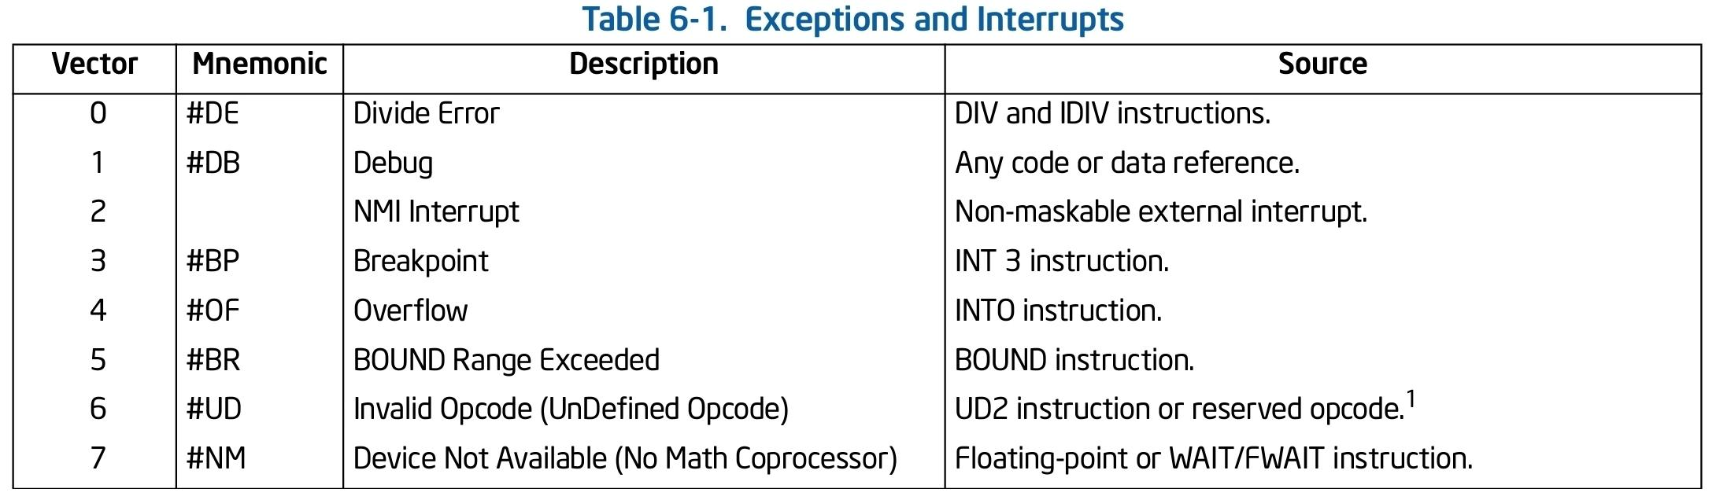
(A brief overview of) Interrupts and Exceptions
In x86-64, indexes 0 through 8, 10 through 14, and 16 through 19 are the predefined interrupts and exceptions; vectors 32 through 255 are for software-defined interrupts, which are for either software interrupts or maskable hardware interrupts.

Slide 33
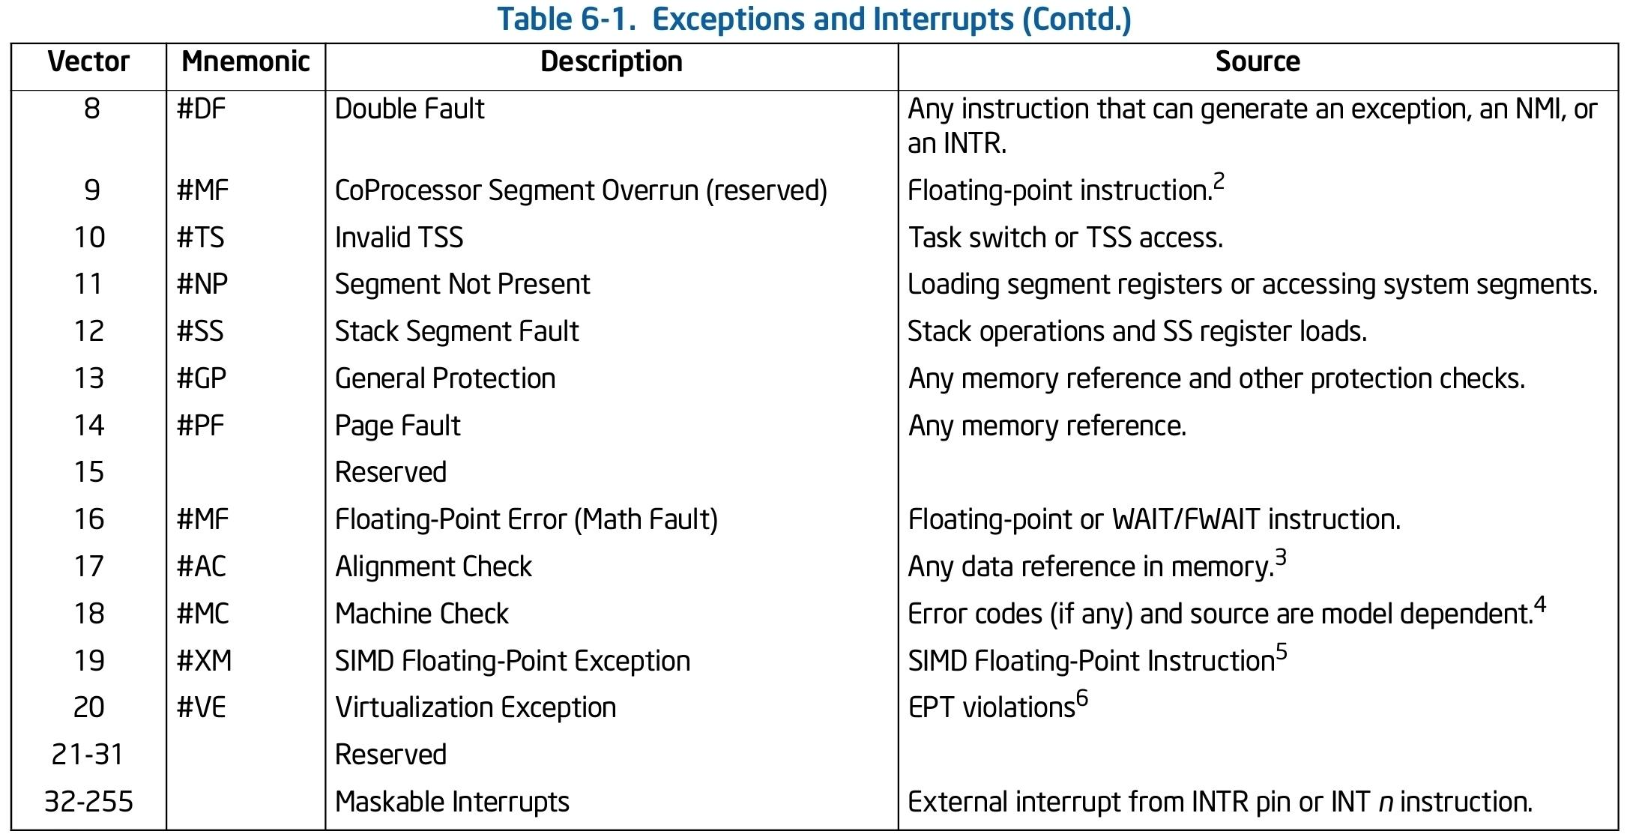
(A brief overview of) Interrupts and Exceptions

Slide 34
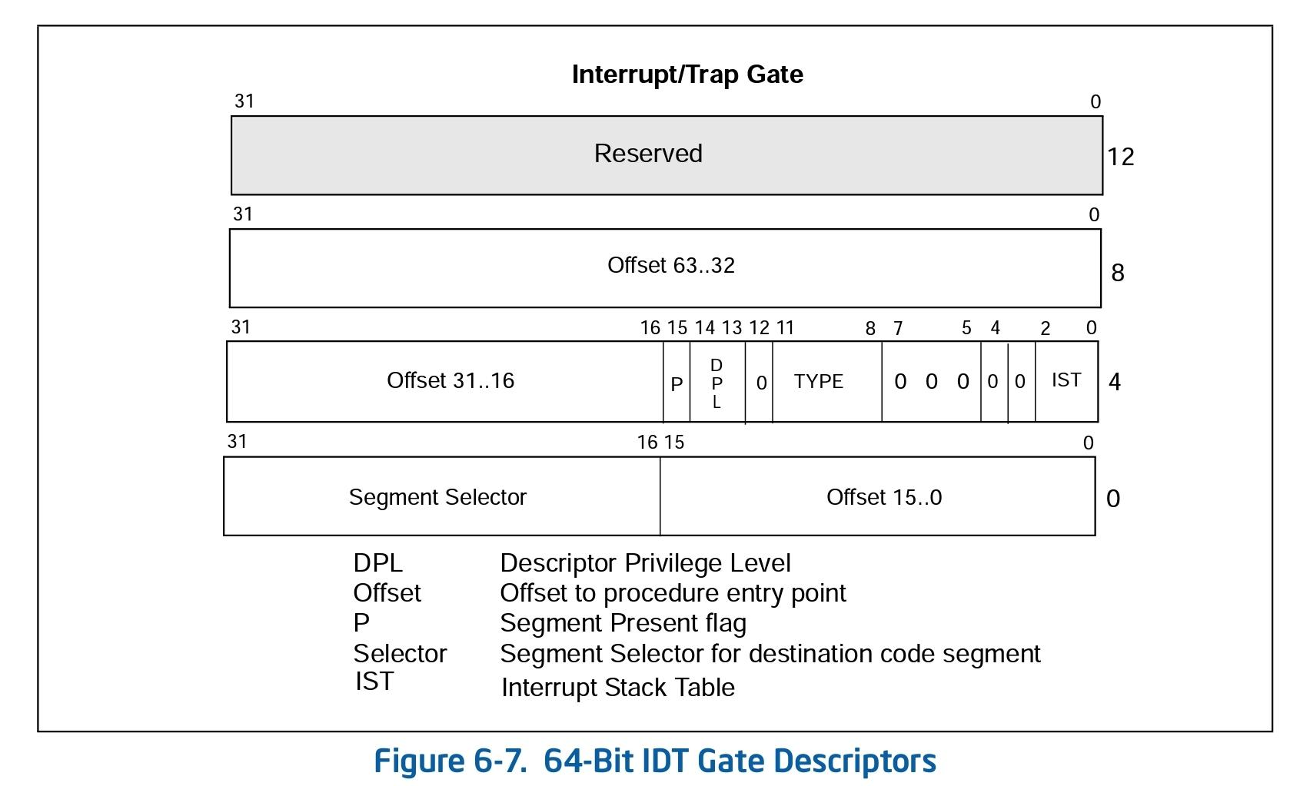
(A brief overview of) Interrupts and Exceptions

Slide 35
Signals (brief overview)
Signals are signals that can be sent to a process, notifying it that some special event has occur.
They offer a way for the os (kernel) to call user code designed to handle certain events, also asynchroniously (a process can also wait for a signal to be delivered).
Common signals include: SIGINT, SIGSEGV, SIGBUS, SIGCHLD, SIGABRT, SIGALRM….
A handler (code designed to handle the specific signal should it be received by the process) for different signals can be registered via the sigaction system call (older apis exist as well such as the signal system call).
Each signal has a default action in which the process will operate (or in which the system will act with regard to the process) if it receives the signal and no specific handler was registered to handle the specific signal.

Slide 36
Signals (brief overview)
Can be per thread (thead directed, such is SIGSEGV when a segmentation fault occurs in the context of a thread) and can be per process (process targeted, such is SIGABRT (I think)).
Each thread maintains a signal mask, enabling it to mask out (not receive) specific signals (some, such as SIGKILL, SIGABRT, cannot be masked out).
When a signal is sent to a process by the system, the signal is written to a queue*, and is executed when the kernel returns to user mode (say from a system call, timer interrupt, other interrupts).
The kernel sets up the return address of the called signal handler, to specific user code that calls the sigreturn syscall which is designed for returning from signal delivery.
* Not necessarily fifo, we will not go into details.

Slide 37
(A brief overview of) Unprivileged utilities
As mentioned (might have added some that appear only in glibc, and not in the c standard) some utilities from libc:
wrappers to system calls - more or less use the system calls, sometimes sparing some functionality / making the api easier to use.
common operations on strings - strrchr, atoi, itoa, stod128(?), strspn(?)
common memory operations - memmove, memmem, memfrob (?), memccpy
others (math, time…. (?) on all) - mktime, modf, nextafter, adjtime, alarm
fast / lightweight small memory allocations - malloc, free, calloc, alloca.
Note: “The heap” is just a memory allocator implemented in user mode, usually by libc (and many heaps (allocators) could exist, we will perhaps go further into details in the second part of the course).

Slide 38
Files
We will not go over the kernel implementation of files and filesystems (at least for now).
We will only note that linux likes to (try to) treat everything as a file (even the memory).
That being said, talking to (kernel code implementing communication with) devices (aka device drivers*) is done using the file api, and ioctls.
* Drivers need not actually talk to hardware devices, this api is often used to talk to kernel mode modules (code that requires running in kernel mode, that implements some functionality.

Slide 39
Files
In a nutshell, devices (meaning possibly (and possible not) hw device handling kernel code modules) can register paths which can be used by processes to communicate with them and use them, via the file api (open, read, close, mmap (when calling mmap with a file descriptor), ioctl ….).
Such devices register “file operations” - a struct defining the functions that should be called on each such file api operation.
When user code wants to use a file, it opens the file at the specific path with the open syscall and receives a file descriptor (fd) associating the (sometimes a) usage of the file in the current context, w.r.t. the relevant system apis.
When user code calls the syscall associated with a file operation on an fd, eventually the registered function of the device file operations (of the device associated to the fd) is called.

Slide 40
Ioctls - Taking with (kernel mode code) devices
We will hopefully go into depth later on.
In a nutshell, much of the functionality offered by device drivers to user mode code is impemented via ioctls (input/output control).
The ioctl file operation of a device accepts an ioctl code (specific and defined by the device) and additional arguments.
When a device wants to implement some api, it can use the ioctl mechanism to accept input from and return output to calling code, related to a specific operation it supports.

Slide 41
Enough for today

